Slide 1
3D Printing and 3D Creation for Tactile Graphics
Clara Van Gerven
National Federation of the Blind, Jernigan Institute

Slide 2
A new Swiss army knife
3D printing has the potential to be a multi-functional tool, the one machine that can make it all
Flexible
Relatively inexpensive
Already present in many environments
Present a wealth of opportunities for printing and creating 3D graphics
But…
Steep learning curve
Limited materials in consumer models
The hardware requires manual adjustments, willingness to do mechanical maintenance
It is the slowest of tactile graphics I have used to make and print

Slide 3
Before you begin: buy, print, make?
Is 3D the best medium?
Use common sense, experience, guidelines
Can you buy it?
Is printing the best way to obtain a model?
Is there a print-ready file (stl)?
Do you have time to make a model?
Do you have know-how, can you find it, or do you have time to learn?

Slide 4
Can you find a model?
Thingiverse
Open, user-friendly, active community, printing oriented
Sketchup 3D warehouse
123D Content
3Dvia
GrabCAD

Slide 5
Models – cheap ways to create them
Tools:
Tinkercad
OpenSCAD
AutoDesk 123D
3D tin
Photo to Mesh (2.5D)
Sketchup (.stl plugin – doesn’t create very good models)

Slide 6
Can you scan a model?
Do you have a scanner?
If yes, can you do model remediation?
If no, try local printing/scanning

Slide 7
Can you print a model?
Do you have a printer?
If no,
Printing services
Local
Remote
Loan a printer/use one from a nearby makerspace
Buy a printer

Slide 8
Printing services
Local
Shapeways
i.materialise
Sculpteo

Slide 9
3D printers
How to choose?
What build volume (size) do you need?
What materials do you want to use?
Additive vs. subtractive
What is your budget?
Resolution
If additive, nr. of extruders
Consumer market:
Makerbot
Cube

Slide 10
Makerbot Replicator specs
25.2 L x 19.9 W x 15.0 H cm or 9.9 x 7.8 x 5.9 in
PLA (new model)
Additive
$2,899
100 micron resolution
1 extruder

Slide 11
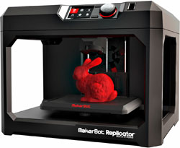
Two cents: Makerbot Replicator
WIN!
LOSE
Very tinkerer-friendly
Good tech support
Decent maintenance instructions
Active user community
Print from USB, network or computer
Very much in need of tinkering
Email only tech support (and not fast)
No design software

Slide 12
Two cents: Tinkercad
WIN!
LOSE
Free
Easy to learn
Great tutorials
Easy export and import of stls
Limited functionality
Online only
Occasional outages

Slide 13
CubeX specs
10.8" x 10.45" x 9.5" or 275mm x 265mm x 240mm
ABS or PLA
Additive
$2,499-$3,999
1 to 3 extruders
100 micron resolution

Slide 14
Two cents: CubeX
WIN!
LOSE
A more polished product
Phone tech support
Custom filament cartridges
Custom platform glue
No printing from computer, only USB
Slow

Slide 15
Two cents: Cubify Invent
WIN!
LOSE
Included with purchase
Extensive tutorials
Better combination of powerful and user friendly than free options
Less than intuitive in places
Print from USB only

Slide 16
Two cents: Netfabb (free version)
WIN!
LOSE
Free
Fabulous fix for bad stl files
Easy to use
Limited functionality

Slide 17
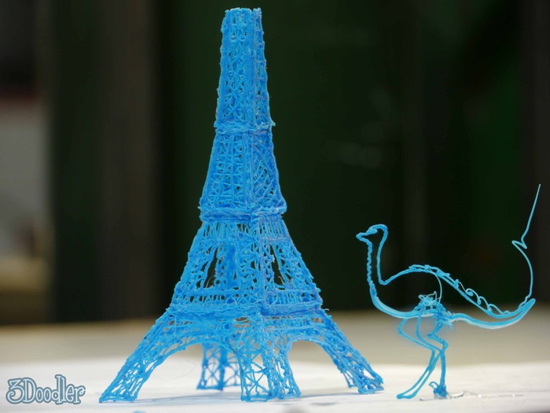
Two cents: 3Doodler
WIN!
LOSE
Inexpensive ($99)
Minimal learning curve
Can draw spatially
Hard to draw
Goes through filament quickly
Custom filament is expensive ($9.99)
Spatial graphics are fragile, flat ones hard to read

Slide 18
Adding context
Add Braille to models
Braille customizables
OpenSCAD script
Does mean you have to learn OpenSCAD
Add audio
Pen Friend
Barcode reader
Tap memo
…
Add other
QR codes
Voiceye

Slide 19
Resources
See resource sheet @ NFB Access Technology Blog
https://nfb.org/blognames/atblog
Presentation
Links to repositories
Links to software info
Links to manufacturers

Slide 20
Contact information
Clara Van Gerven
Access Technology Content Specialist
cvangerven@nfb.org
410-659-9314

