Slide 1
Advancing Disability Rights for Unaccompanied Immigrant Children Within and Outside Government Custody
Anne Kelsey, Disability Policy Analyst at the Young Center
Amy Leipziger, Project Director, Free to Be Youth Project, Urban Justice Center
Notes:
Anne and Amy introduce themselves
Anne presents the focus of the panel
Today, Amy and I will be discussing how failures to provide individualized and trauma-informed services in both the federal immigration system and education system disproportionately harm unaccompanied immigrant children with disabilities.
As you’ll hear shortly, I will focus on the specific and disproportionate harms immigrant children with disabilities face when they are held in restrictive detention facilities, specifically as it pertains to the federal government’s “significant incident reporting system.”
Later, my colleague Amy, who has extensive experience representing immigrant children with disabilities in the education system, will talk about how the challenges immigrant children encounter in federal custody often follow them after their release into other systems such as the education system.
As Amy will share, school districts across the country often exacerbate the difficulties immigrant children with disabilities face by failing to provide inclusive language access and culturally informed services, which can make it exceedingly difficult for any child, but especially immigrant children with disabilities, to adapt and develop.

Slide 2
YOUNG CENTER CHILD ADVOCATES
Evaluate and represent the child’s best interests while the child is subject to immigration proceedings:
Care
Custody
Release
Permanency
Repatriation
Notes:
The Young Center is the only organization in the country that trains and provides independent volunteer Child Advocates to accompany and support unaccompanied and separated immigrant children navigating our country’s immigration system. Through a trauma-informed, multidisciplinary lens, our Child Advocates are trained to advocate for the wishes, best-interests,
In addition to being the only organization in the country to lead this type of program, what makes our Child Advocate Program unique is that role of Child Advocates is very personal.
Appointed to the most vulnerable youth.
We connect one advocate per child to give that child individualized attention and care.
The work they do is strictly confidential
And our Child Advocates meet with children every single week, develop trust, get to know the child, get to know their circumstances and challenges, and then issue recommendations to key decisionmakers who are charged with making life-altering decisions about children’s immigration cases and futures.
We also provide post-release support, ensuring children are supported after their released from custody and reunited with families or in the care of sponsors.

Slide 3
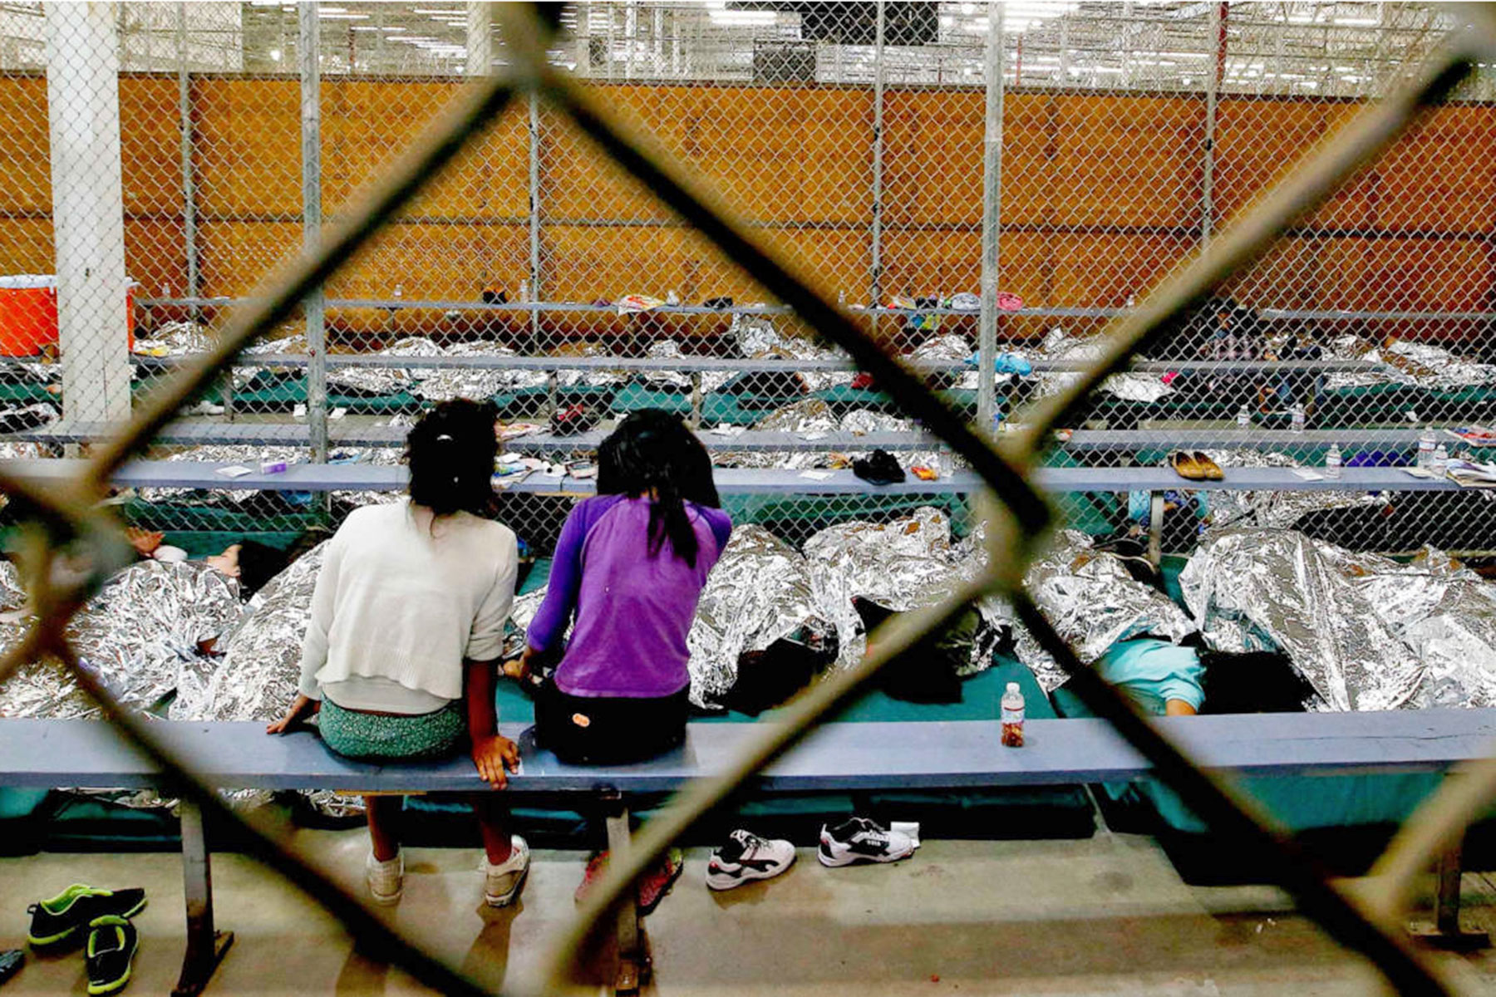
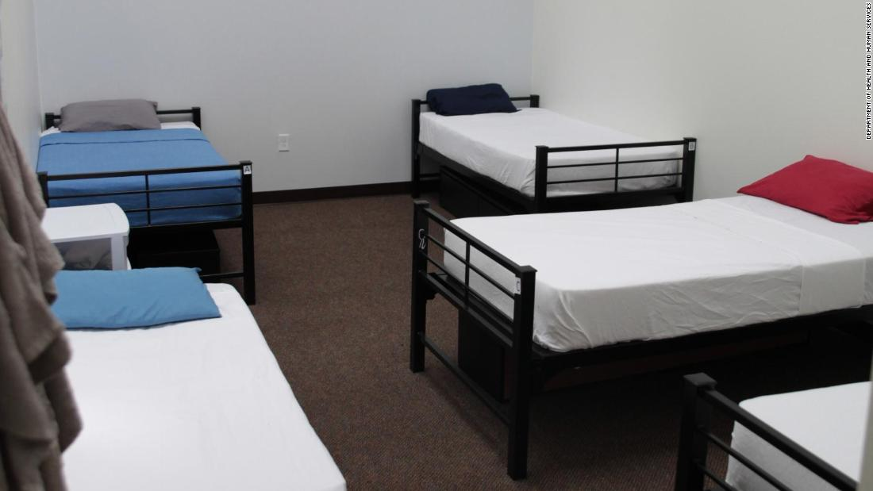
Path of Custody of Unaccompanied Children
Apprehension and Processing at Border (DHS)
Transfer to ORR operated “Shelters” across U.S. (HHS)
Release to family or sponsors while immigration case continues
Child appears in immigration court to seek permission to remain in U.S.
Notes:
Unaccompanied children are children and youth under the age of 18, who are encountered at the border or in the interior of the US by immigration officials, and who are not with a parent or legal guardian. They include children who venture to our borders on their own or with smugglers or traffickers but also children who arrive with adult family members who are not their legal guardians.
If these children can make it to our border, and survive the myriad policies trying to keep them away, they will—within 72 hours of encountering a border official—be transferred into the custody of the federal dep’t of health and human services and that agency’s office of refugee resettlement, known as ORR. ORR is tasked with caring for the children until they can be released to family, or transferred to a small federal foster care system.
ORR contracts with organizations across the country to operate facilities where children are held in custody, under state licensing standards, until they can be released to family. The average length of stay is around a month. And for children with any kind of challenge—including but not limited to disabilities—lengths of detention are generally much longer and can reach years.
Note that once children are released from ORR custody, ORR will not take them back – when there are sponsor breakdowns of family disruptions, youth will be referred to domestic child welfare system.

Slide 4
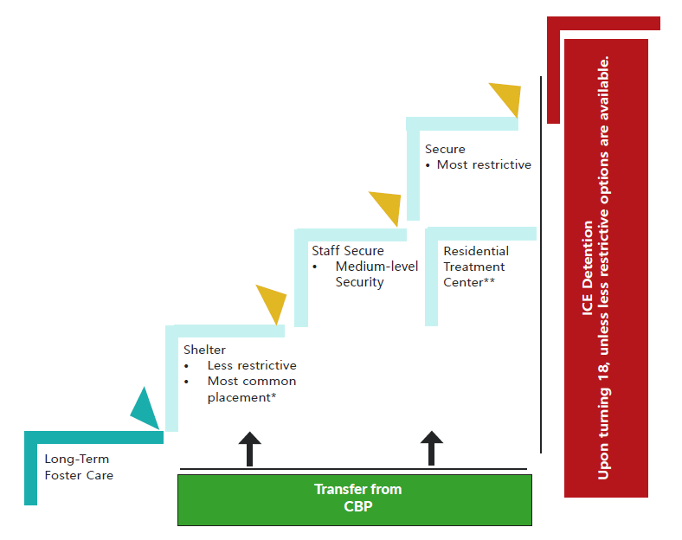
Office of Refugee Resettlement (ORR)

Slide 5
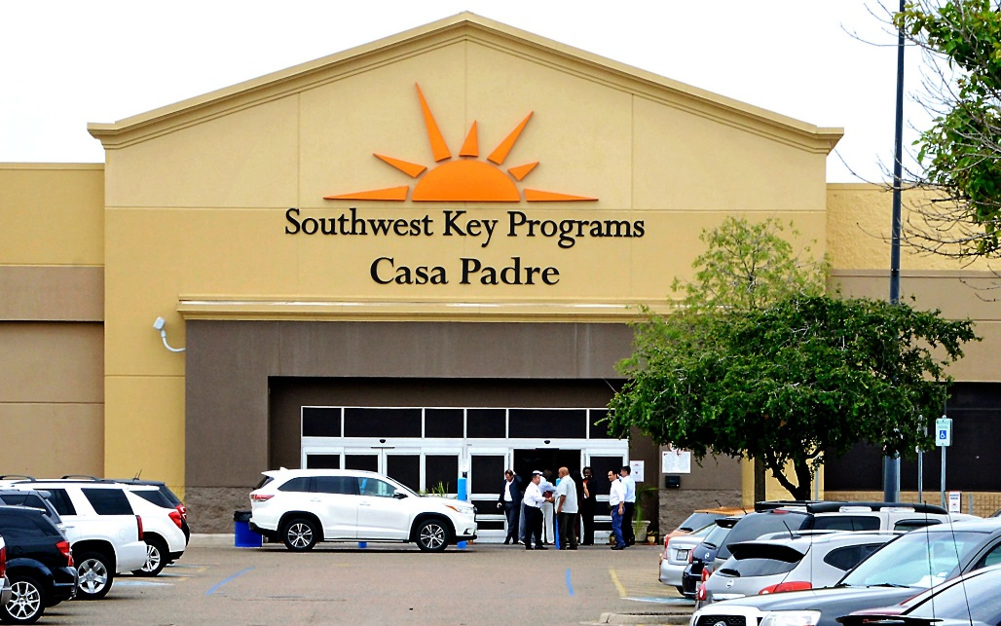
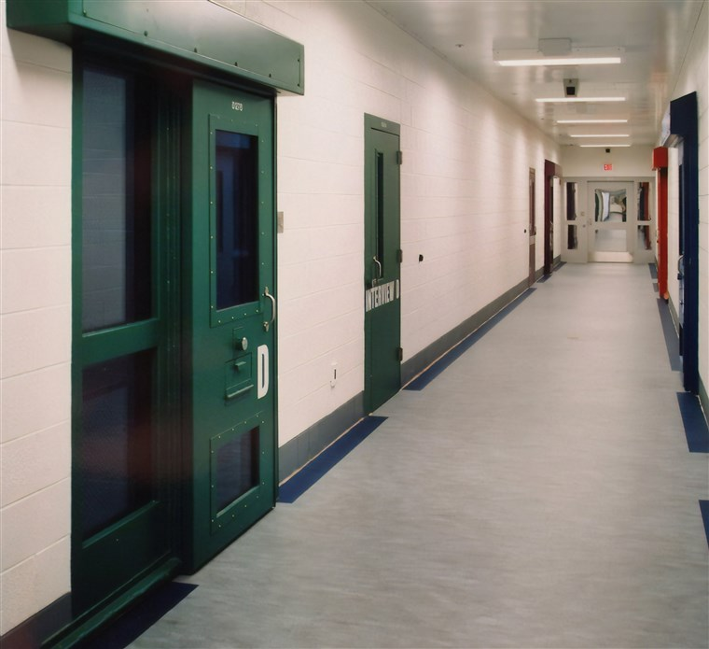
Range of Placements for Children in Custody
Home-based foster care
Shelter (15-1500 beds)
Staff Secure & RTC
Secure
Least Restrictive
Most
Restrictive
Notes:
ORR has a statutory obligation to place children in the least restrictive setting in their best interests. The overwhelming number of ORR beds are in so-called shelters. But these are fundamentally different from the shelter placements in the state child welfare system, which has moved away from institutionalization and toward small placements for children who cannot live with family. Today, most ORR facilities are multi-hundred-bed facilities. True, some of them are designed in a campus-like manner, with small cottages where children sleep and larger buildings for classes, meals, and services. But many of the facilities are giant buildings—pictured here is a former Walmart that was converted to a facility for 1400 boys.
The actual least restrictive placement is to the left—what ORR refers to as short-term and long-term foster care. These are foster care homes that are not intended to be long-term, but for brief stays before a child’s release to family. But these are few and far between in the ORR network.
On the other end of the spectrum are staff secure facilities, residential treatment centers, and secure placements. Each are increasingly more restrictive and they often have spaces where children are intentionally isolated. The secure facilities are beds in juvenile detention facilities, even though the children have not been adjudicated delinquent.

Slide 6
The Numbers in 2022
Overall
128,904 children entered ORR custody
Average length of stay was 30 days
65% male/35% female
Top countries of origin: Guatemala, Honduras, El Salvador
15% ages 0-12; 13% ages 13-14; 36% 15-16; and 36% age 17
Young Center in 2022​
Served 1,600+ children​
From 35 countries​
Speaking 56 languages​
~ 25% under 12; ~ 25% 17 years old

Slide 7
Legal Framework Awaiting Children and Youth

Slide 8
Rights of Asylum Seekers
Protection from well-founded fear of persecution on account of enumerated ground
Expedited removal for anyone arriving at border
No right to counsel
Adversarial, non-Article III court-based hearings drag on for years
Permanency
Citizenship requires five year wait
Right to work
But not until 6+ months after application file
Notes:
The United Nations 1951 Convention and 1967 Protocol define a refugee as a person who is unable or unwilling to return to his or her home country, and cannot obtain protection in that country, due to past persecution or a well-founded fear of being persecuted in the future “on account of race, religion, nationality, membership in a particular social group, or political opinion.” Congress incorporated this definition into U.S. immigration law in the Refugee Act of 1980. Asylum is technically a “discretionary” status, meaning that some individuals can be denied asylum even if they meet the definition of a refugee. For those individuals, a backstop form of protection known as “withholding of removal” may be available to protect them from harm if necessary.
As a signatory to the 1967 Protocol, and through U.S. immigration law, the United States has legal obligations to provide protection to those who qualify as refugees. The Refugee Act established two paths to obtain refugee status—either from abroad as a resettled refugee or in the United States as an asylum seeker.

Slide 9
The 1997 Flores Settlement Agreement
Not created from rights-based framework, but the outcome of a lawsuit intended to stop egregious harms perpetrated against children by immigration officials
Prioritizes reunification with family
Creates tiered hierarchy of detention sites (least to most restrictive)
Mandates adequate food, beds, outdoor time
Notes:
The floor for conditions of custody

Slide 10
Trafficking Victims Protection Reauthorization Act (TVPRA)
Protections
Codifies presumption of reunification with family pending adjudication of claim for protection
Opens door to affirmative asylum proceedings (though children remain in removal proceedings)
Codifies ‘best interests’ by permitting appointment of independent Child Advocates
Drawbacks
Increased suspicion of families (codifies intrusive surveillance)
Children with disabilities must get a home study
Children as victims, not rights-holders
No right to counsel
Undermines idea of universal rights/needs
excludes all children from Mexico
excludes accompanied children (children arriving with parents)

Slide 11
Section 504
Applies to ORR and its grantee providers
Covered entities must:
Provide services and programs in the most integrated setting appropriate to the needs of the qualified individual with a disability
Ensure that programs, services, activities, and facilities are accessible
Make reasonable modifications in their policies, practices, and procedures to avoid discrimination on the basis of disability
Provide auxiliary aids to persons with disabilities, at no additional cost, where necessary to afford an equal opportunity to participate in or benefit from a program or activity
Integration Mandate

Slide 12
Policy Overview: The Problems We See Now
The system does not recognize the inherent harm of institutional settings and separation from family and community.
ORR facilities do not provide individualized, culturally-competent, trauma- informed disability-related and mental health care.
Kids with disabilities experience disproportionate punishment and write-ups (SIRs) and are punished for behavior that is a result of their disability.
Kids with disabilities, particularly mental health and trauma related disabilities, spend longer in custody in more restrictive settings

Slide 13
Immigration is a disability justice issue
Fight for disability-related services and supports in custody, while knowing that children thrive when they’re with family and in community.
Connect kids to community supports and services. Undocumented children should be able to access services in the community like their documented peers.
Minimize family separation.
Ensure access to counsel and child advocates.
Connect disability and immigrant advocates.
Notes:
Policy priorities
Examples: Wraparound care coordination, behavioral support services, peer support, family support and training services, in-home therapy with a licensed clinician, children’s mobile crisis response; physical, occupational, and speech therapy.

Slide 14
Relevant cases: Lucas R. v. Azar (C.D. Cal)
Brought by National Center for Youth Law in 2018 alleging that ORR overuses psychotropic medications; discriminates against children with disabilities; wrongly places children in unnecessarily restrictive settings; arbitrarily denies children release to their family; and denies children access to legal counsel.
5th Amendment and Section 504 Claims
March 2022 decision held that UCs are entitled to greater constitutional protections than they are currently afforded when they are detained in restrictive placements or denied release to family; remaining claims are in negotiation.
Case documents: https://youthlaw.org/cases/lucas-r-v-azar

Slide 15
Relevant cases: Doe v. Shenandoah Valley Juvenile Center Commission (W.D. Va and 4th Cir.)
Brought by Washington Lawyers’ Committee for Civil Rights in 2017 alleging that UCs who are detained at the Shenandoah Valley Juvenile Center (a secure facility) were wrongfully deprived of adequate mental health care in violation of 5th/14th Amendment
https://www.wiley.law/assets/htmldocuments/Shenandoah%20Valley%20Complaint.pdf
January 2021 decision by the 4th Circuit reversed the district court's grant of summary judgment to Defendant Shenandoah (ORR not a party) and held that the proper standard is whether Defendant's actions departed from accepted professional judgment, not deliberate indifference; and on remand, district court should consider evidence on trauma-informed care and the professional judgment standard.
Doe v. Shenandoah, 985 F.3d 327 (4th Cir. 2021)

Slide 16
Relevant cases: Doe v. Shenandoah Valley Juvenile Center Commission (W.D. Va and 4th Cir.)
Shenandoah is now closing as a result of the litigation, leaving ORR with no secure placements.
However, ORR has issued a Notice of Funding to contract with 5 new secure facilities (licensed as juvenile detention facilities).
Department of Health and Human Services Administration for Children and Families - ORR, HHS-2023-ACF-ORR-ZU-0008 Residential (Secure) Services for Unaccompanied Children (Jan 12, 2023), available at https://www.grants.gov/web/grants/view-opportunity.html?oppId=344685.

Slide 17
Relevant cases: A.F.B. v. Becerra
A habeas case brought by Disability Rights California to challenge the unlawful transfer of an Afghan UC from a foster care setting in California to a locked psychiatric facility in Utah.
Youth had never been assessed or diagnosed with any disability.
Alleges violations of the Constitution, TVPRA, Flores settlement, Unruh Act, and Section 504.
Case is ongoing.
Notes:
Explain Afghan issue

Slide 18
What are SIRs?
Significant Incident Reports” (SIRs) are forms that ORR uses to document a wide array of incidents ranging from disclosures of past abuse or neglect to minor rule infractions within ORR facilities, as well as behavioral challenges.
ORR policies and procedures have created a system in which a range of behaviors, words or actions, regardless of their seriousness or significance, trigger SIRs on a daily basis.
ORR facilities are incentivized to over-report, with facility staff erring on the side of reporting many minor and trivial incidents to ensure that they are complying with ORR policies.
Notes:
“Inaccurate” + “incomplete” per ORR
Can prolong children’s time in custody and delay reunification with loved ones.
ORR consistently uses SIRs to over-report incidences of children under its supervision.
SIRs can have devastating consequences on a child’s immigration case and permanency
Children with disabilities disproportionately incur SIRs.

Slide 19
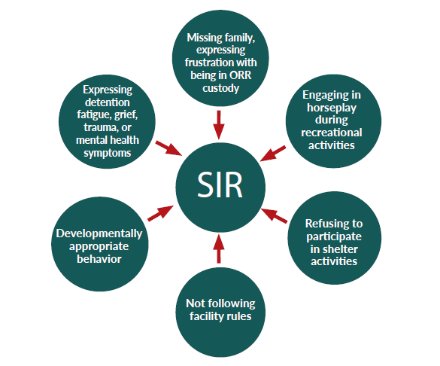
What behaviors can lead to an SIR
Notes:
Small rule infractions (sharing food, getting up to go to the bathroom too soon)
Horseplay
Boundary challenging behavior
Disclosing past harm suffered
Manifestations of trauma, grief, or disability

Slide 20
SIRs can…
Prolong children’s stay in custody
Lead to more restrictive placements or “step ups”
Denial of “Step-Down” to less restrictive placements
Delay or Denial of release from ORR to sponsor/family
Delay or Denial of placement in
Foster care
Unaccompanied Refugee Minors program
Lead to a child’s transfer to ICE detention when turning 18
Adversely impact legal relief applications (e.g., asylum)
Lead to calls to police & criminalization of children
Undermine staff-child relationships and children’s trust in staff
Notes:
Can prolong children’s time in custody and delay reunification with loved ones.
ORR consistently uses SIRs to over-report incidences of children under its supervision.
SIRs can have devastating consequences on a child’s immigration case and permanency
Children with disabilities disproportionately incur SIRs.
SIRs have become a driving force of ORR’s disciplinary structure rather than a tool to ensure children, including children with disabilities, receive the care they need.
Sound familiar from school setting

Slide 21
Punishing Children’s Disabilities
Children with disabilities are disproportionately punished for demonstrating behavior that is inherently related to their disabilities. These behaviors get reported in SIRs, which can result in a greater number of children with disabilities being stepped up into more restrictive placements for longer periods of time.
SIRs are written up for behavioral incidents that could likely have been avoided with the implementation of effective crisis prevention and de-escalation techniques tailored to the unique needs and challenges of the child.
Notes:
In ORR custody, children’s trauma can manifest in multiple ways, as they may not have the tools, family or community contacts, or care they need to self-soothe or regulate their emotions. Sometimes, children experience grief over separation from family or because they learn of more violence afflicting their loved ones. ORR facility staff may characterize their behavior as aggressive or harmful to themselves or others, resulting in more restrictive placements.
A 2019 report by Disability Rights California found that “ORR guidelines fail to take into adequate consideration whether a child’s self-harming or disruptive behaviro could be arising from unmet mental health needs, illnesses, or trauma.”
ORR facilities have repeatedly been found to lack adequate mental health services, and instead of addressing this longstanding problem, ORR has created a system in which children with mental health needs who manifest behavior linked to their disabilities have SIRs written up, are punished, and are held in restrictive settings, often in conditions that only exacerbate their mental health challenges and compound their trauma.

Slide 22
Education Issues In Custody
According to ORR guidance, state-licensed facilities must conduct an initial educational assessment within 72 hours of admission to determine the child’s level of academic development, literacy, and linguistic abilities.
This is bare bones assessment fails to include any evaluation that might be useful in determining suspected disabilities or needs for special education
Nor does it include an evaluation that might be useful in determining if there is history of trauma , their social emotional well-being, or any possible mental health issues that could impair learning

Slide 23
Education Issues in Custody
Once the assessments have been completed, children in custody are required to be provide with six hours of instruction per day, Monday through Friday, in a structured classroom environment, throughout the calendar year.
This includes teaching in basic subject areas, including science, social studies, mathematics, reading, writing, physical education, and English-language development

Slide 24
Education Issues in Custody
Educational services in HHS shelters do not receive state or local funding because they are contracted to nonprofits and private organizations.
Consequently, those providing education to children in ORR custody are not legally required to adhere to state educational standards NOR is the state involved in monitoring them.
Frequent issues that arise:
Teachers at the schools in ORR facilities are sometimes not state-certified as teachers
Some shelter instructors cannot communicate effectively in Spanish
The curriculum is so limited and classes are so wide-ranging in age groups that students are bored, disengaged and unable to engage.
In sum, education services are inconsistent and impossible to monitor

Slide 25
Education Issues in Custody
ORR shelters are required to provide academic reports and progress notes for every student; educational and classroom materials that reflect the children’s cultural background and are sensitive to cultural differences; materials in all native languages represented at the facility
Notably, these reports are often lacking in critical details that determine a child’s needs
In short ORR shelters are not equipped to consider how a child with a disability may affect their needs in custody

Slide 26
Trauma in Custody
Adverse childhood experiences are stressful or traumatic events, including interpersonal traumas such as physical or emotional abuse, neglect, and parental separation. But trauma also includes systemic trauma, like poverty, lack of access to food or housing, persistent exposure to racism and other forms of discrimination, and community violence.
Children who are exposed to trauma in various forms are more vulnerable to chronic health problems, mental illness, and difficulties with substance abuse in adulthood. ACEs have also been shown to impact brain development in a way that affects participation in education, employment stability, and criminal justice-involvement in adulthood. Exposure to ACEs increases the risk for repeated trauma exposure across a person’s life.
Notes:
In ORR custody, children’s trauma can manifest in multiple ways, as they may not have the tools, family or community contacts, or care they need to self-soothe or regulate their emotions. Sometimes, children experience grief over separation from family or because they learn of more violence afflicting their loved ones. ORR facility staff may characterize their behavior as aggressive or harmful to themselves or others, resulting in more restrictive placements.
A 2019 report by Disability Rights California found that “ORR guidelines fail to take into adequate consideration whether a child’s self-harming or disruptive behaviro could be arising from unmet mental health needs, illnesses, or trauma.”
ORR facilities have repeatedly been found to lack adequate mental health services, and instead of addressing this longstanding problem, ORR has created a system in which children with mental health needs who manifest behavior linked to their disabilities have SIRs written up, are punished, and are held in restrictive settings, often in conditions that only exacerbate their mental health challenges and compound their trauma.

Slide 27
Trauma in Custody
Immigrant youth, in particular those that are unaccompanied youth are at high risk for repeated exposure to psychosocial stressors before, during, and after their migration to the United States. The American Academy of Pediatrics has recognized the psychosocial stress that immigration detention, even for short periods of time, causes both adults and children. Students with trauma-related learning challenges may struggle to understand material, become frustrated with or disengaged from learning, have poor attendance, or engage in behaviors that interfere with classroom learning.
They may also experience physiological and threat-response impacts that interfere with learning, like intrusive thoughts that disrupt their focus, hypervigilance that impairs understanding, panic or anxiety attacks that interrupt their day, or fatigue.
Notes:
In ORR custody, children’s trauma can manifest in multiple ways, as they may not have the tools, family or community contacts, or care they need to self-soothe or regulate their emotions. Sometimes, children experience grief over separation from family or because they learn of more violence afflicting their loved ones. ORR facility staff may characterize their behavior as aggressive or harmful to themselves or others, resulting in more restrictive placements.
A 2019 report by Disability Rights California found that “ORR guidelines fail to take into adequate consideration whether a child’s self-harming or disruptive behaviro could be arising from unmet mental health needs, illnesses, or trauma.”
ORR facilities have repeatedly been found to lack adequate mental health services, and instead of addressing this longstanding problem, ORR has created a system in which children with mental health needs who manifest behavior linked to their disabilities have SIRs written up, are punished, and are held in restrictive settings, often in conditions that only exacerbate their mental health challenges and compound their trauma.

Slide 28
Trauma in Custody
The current system of education in ORR custody has a glaring hole-in that there is no mention of what to do when a child in custody presents with a disability (either has one, and is known, or is not evaluated at all).
Nor does the current system reflect the complex needs of children dealing with trauma.

Slide 29
Education Issues out of Custody
To be enrolled in school requires Residency: physical presence + intent to reside in the district
Plyer v. Doe – US Supreme Court decision recognized that undocumented children cannot be denied a free public education if they are district residents.
At enrollment/registration, districts should avoid asking questions related to immigration status or that may reveal immigration status.

Slide 30
Education Issues: Language
One of the many challenges that we’re seeing in NYC lately is that of language access
For example, monolingual students have significant language needs and need bilingual support in the classroom
In the fall there were an estimated 5,000 more students enrolled as part of the busing programs and higher numbers of migrants arriving in the City.

Slide 31
Education Issues: SIFE
What is SIFE?
Students with Interrupted/ Inconsistent Formal Education and ELL who have attended school in the US for less than 12-months and
who, upon initial enrollment in such schools are two or more years below grade level in literacy in their home language and/or two or more years below grade level in mathematics
Due to inconsistent or interrupted schooling prior to arrival in the United States.

Slide 32
Education Issues: ORR File
Another common issue is that of the ORR file. When a youth is released, the ORR file is given to the sponsor or adult; however, most of them aren’t informed as to its contents or its uses.
School systems won’t ask for the ORR file because they can’t ask about immigration status
However the ORR file will include the assessments and records of the child’s academic ability
In some instances it may also include psychological or other evaluations that can be instructive and critical to a student enrolling in school

Slide 33
Access to Special Education
Immigrant students are entitled to special education services like any other student.
*Caution* - Must be careful that immigrant students are not mistakenly identified as having a disability.
Cultural Competency issues (e.g. behavioral norms, social skills, cultural bias, etc.)
English proficiency issues (e.g. academic delays, standardized tests, etc.)
Parents or Sponsors do not have to agree to the evaluation or to special education services.

Slide 34
Trauma and Special Education
P.P. v. Compton Unified Sch. Dist., 135 F.Supp.3d 1098, Case No. 15-3726-MWF (PLAx) (C.D. Cal. 2015)
Can exposure to traumatic events cause physical or mental impairments that are cognizable as disabilities under 504 and the ADA?
Yes, because complex trauma
Results in neurobiological effects, like changes in brain size and chemistry, that constitute a physical impairment
AND causes limitations in students’ abilities to perform tasks like learning, reading, concentrating, thinking, and communicating

Slide 35
Hypothetical
A 15-year-old immigrant student who recently immigrated from El Salvador and was placed with an aunt after leaving ORR custody, enrolls in the local school district. The youth’s personal history includes a gap in formal education, documented experiences of sexual violence, and indications of a learning disability (although they have never been assessed).
What sort of services should they be entitled to? How would you advocate for this child? What barriers might you face?

Slide 36
QUESTIONS?

