Slide 1
Accessible Information and Effective Communication in Healthcare Settings

Slide 2
Presenters
Steven E. Gordon
Assistant United States Attorney
Civil Rights Enforcement Coordinator
USAO Eastern District of Virginia
Lisa Bothwell
Program Analyst
U.S. Department of Health and Human Services
Administration for Community Living
John Thompson
Civil Rights Analyst
U.S. Department of Health and Human Services
Office for Civil Rights

Slide 3
Disclaimer
Opinions expressed herein or otherwise are those of the speakers and do not necessarily reflect the views of the United States Department of Justice or the United States Department of Health and Human Services.

Slide 4
Federal Government Statistics
The CDC estimates that approximately 64 million adults aged 18 or older in the United States had some kind of disability in 2020. CDC Disability and Health Data System.
Based on a hearing loss prevalence study, the National Institute on Deafness and Other Communication Disorders (NIDCD) reports that one in eight people in the United States (13 percent, or 30 million) aged 12 or older has hearing loss in both ears, based on standard hearing examinations.

Slide 5
What is Covered by the ADA?
The ADA prohibits discrimination and ensures equal opportunities for persons with disabilities in:
Employment (Title I)
State and local government services (Title II)
Public accommodations (Title III)
Telecommunication Services (Title IV)

Slide 6
Title II Covers Public Entities
All state and local governmental entities are covered by Title II, including the following entities operated by state and local governments that have a healthcare mission:
Hospitals operated by state or local governments, including state universities and psychiatric hospitals.
State and local mental health agencies.
State universities that have infirmaries.
Jails and correctional facilities, including their infirmaries.

Slide 7
Title III Covers Private Sector Hospitals, Nursing Homes and Other Health Care Providers
Title III covers “public accommodations,” which include a wide range of entities, such as:
(1) Hospitals;
(2) Nursing homes; and
(3) Professional office of a health care provider.
42 U.S.C. § 12181(7)(K); ADA Technical Assistance Manual, § III-1.2000.C. (1994 Supplement) (“nursing homes are expressly covered in Title III regulations as social service establishments”).

Slide 8
Section 504 of the Rehabilitation Act and Section 1557 of the Affordable Care Act
Section 504 of the Rehabilitation Act applies to recipients of Federal financial assistance (FFA). This includes most:
Hospitals;
Nursing Homes; and
Physician’s Offices.
Section 1557 of the Affordable Care Act (ACA) applies to covered health programs and activities provided by covered entities, including:
Health programs and activities that receive FFA;
Programs or activities administered by HHS under Title I of the ACA; and
Programs or activities administered by an entity established under Title I of the ACA.
Sections 504 and 1557 provide similar protections for individuals with disabilities to those provided under the ADA.

Slide 9
Question 1
A skilled nursing facility (SNF) operated by a private entity provides a variety of services to its residents, including healthcare, medication administration, assistance with activities of daily life, and providing meals. Is it covered by the ADA? Section 504? Section 1557?

Slide 10
Answer 1
Both privately operated and state operated SNFs are covered by the ADA. SNFs that receive financial assistance from the Federal government are covered under Sections 504 and 1557.

Slide 11
Definition of Disability
A physical or mental impairment that substantially limits one or more major life activities (e.g., hearing, seeing, walking or operation of bodily function such as immune system).
A record of such an impairment.
Being regarded as having such an impairment.
42 U.S.C. § 12102

Slide 12
Major Life Activities Include, but are not Limited to:
Caring for oneself, performing manual tasks, seeing, hearing, eating, sleeping, walking, standing, lifting, bending, speaking, breathing, learning, reading, concentrating, thinking, communicating, and working.
A major life activity also includes the operation of a major bodily function, including but not limited to, functions of the immune system, normal cell growth, digestive, bowel, bladder, neurological, brain, respiratory, circulatory, endocrine, and reproductive functions.

Slide 13
ADA Requires Public Accommodations, Including Health Care Providers to Provide Equal Services
The general principle underlying the ADA is that “[n]o individual shall be discriminated against on the basis of disability in the full and equal enjoyment of the goods, services, facilities, privileges, advantages, or accommodations of any place of public accommodation by any person who owns, leases (or leases to), or operates a place of public accommodation.” 42 U.S.C. § 12182(a).

Slide 14
Discrimination Under the ADA is not Limited to Affirmative Animus
“The ADA . . . Specifically prohibits discrimination against [individuals with disabilities], not just based on invidious ‘affirmative animus,’ but also based on thoughtlessness, apathy, and stereotypes about disabled persons.”
Notes:
Guckenburg v. Boston University, 974 F.Supp. 106 (D.Ma. 1997).

Slide 15
Examples of Prohibited Practices Under Federal Disability Rights Laws1
Failing to provide auxiliary aids or services to individuals who have communication disabilities. 42 U.S.C. § 12182(b)(2)(A)(iii); 28 C.F.R. §§ 35.160 & 36.303; 45 C.F.R. § 84.52(d); 45 C.F.R. § 92.102.
Imposing a surcharge on an individual with a disability to cover the cost of compliance with the ADA. 28 C.F.R. § 35.130(f); 28 C.F.R. § 36.301(c).
Failing to “make reasonable modifications to policies, practices, or procedures when the modifications are necessary to avoid discrimination on the basis of disability, unless the public entity can demonstrate that making the modifications would fundamentally alter the nature of the service, program, or activity.” 42 U.S.C. § 12182(b)(2)(A)(ii); 45 C.F.R. § 92.105.

Slide 16
Question 2
A skilled nursing facility does not accept individuals who are deaf and communicate using sign language because it does not offer sign language services. Is this a potential violation of Federal disability rights laws?

Slide 17
Refusal To Admit Individual Who Needed Sign Language Interpreting Services
Brookside Rehab & Health Center
Refused admission to an individual who need sign language interpreting services. Equitable relief, $40,000 in compensatory damages, and $50,000 in civil penalty.
https://www.ada.gov/brookside_rehab_sa.html

Slide 18
Effective Communication
Entities must take appropriate steps to ensure that communication with people with disabilities is as effective as communication with others, including through the provision of appropriate auxiliary aids and services. 28 C.F.R. § 35.160(a)(1); 45 C.F.R. § 92.102(a).
The type of auxiliary aid needed to provide effective communication will vary by context and depends on many factors.

Slide 19
Question 3
A new patient who has a communication disability comes for services. How do you determine what auxiliary aid or service is necessary?

Slide 20
Answer 3
The type of auxiliary aid needed to provide effective communication will vary by consumer and depends on many factors.

Slide 21
Factors to Consider to Determine the Type of Auxiliary Aid for Effective Communication
(1) What is the method of communication used by the individual? (e.g., ASL, signed English, oral interpreter)
(2) How lengthy is the communication?
(3) How complex is the communication?
(4) What is the nature of the communication?
(5) What is the context of the communication?
Notes:
28 C.F.R. § 35.160(b)(2).

Slide 22
Consultation
The ADA regulations explain that public accommodations “should consult with individuals with disabilities whenever possible to determine the type of auxiliary aid is needed to ensure effective communication.” 28 C.F.R. § 36.303(c)(1)(ii).

Slide 23
Method of Communication Used by the Individual: ASL
“ASL is not derived from English; ASL has its own syntax and grammar and utilizes signs made by hand motions, facial expressions, eye gazes, and body postures. Therefore, the vast majority of deaf people–[plaintiff] included– lack the ability to communicate effectively in English, whether by writing notes or reading lips.” Pierce v. District of Columbia, 128 F.Supp.3d 250, 275 (D.D.C. 2015) (cites to record omitted) (emphasis added).

Slide 24
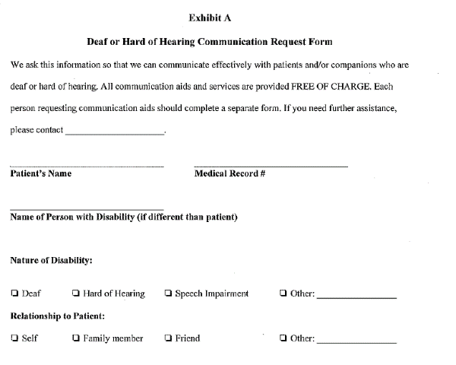
Communication Request Forms in DOJ ADA Settlements are Useful Tools to Obtain Individualized Information

Slide 25
The Auxiliary Aid Must Work for the Individual
There are many types of auxiliary aids and services, including, but not limited to:
Real-time captioning (a.k.a., CART);
CapTel Phone;
Cued-speech interpreter;
Assistive listening systems and devices;
Hearing-aid compatible telephones;
Videophones; and
Sign language interpreting (ASL, signed English, etc.).
28 C.F.R. § 35.104; 28 C.F.R. § 36.303(b).

Slide 26
CART
“Computer Assisted Real-Time Transcription (“CART”)
Many people who are deaf or hard of hearing are not trained in either sign language or speech reading. CART is a service in which an operator types what is said into a computer that displays the typed words on a screen.”
DOJ ADA Business Brief: Communicating with People who are Deaf or Hard of Hearing in Hospital Settings

Slide 27
There are Many Kinds of Assistive Listening Devices
Personal amplifiers
Hearing aid compatible telephones
TTY
Other technology, including captioned telephones (such as Captel phones)

Slide 28
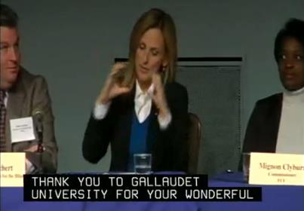
Captioning & Telecommunications
Information provided by video should be captioned
Televisions for patients in hospitals
TTY, if telephone is offered to others
Telehealth and web content video platforms

Slide 29
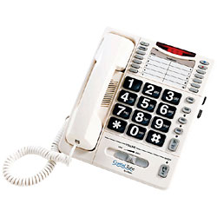
Hearing Aid Compatible Telephones and Amplified Telephones

Slide 30
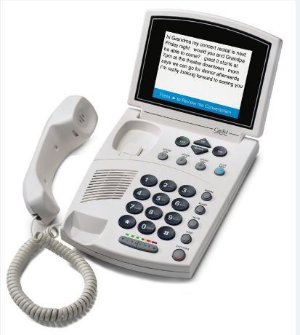
Captioned Telephones

Slide 31
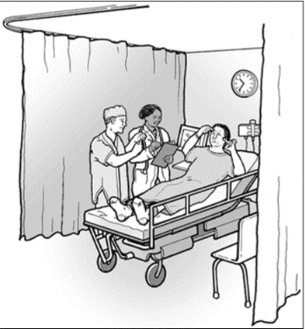
Sign Language is an Auxiliary Aid or Service
A doctor uses sign language interpreter to communicate with a patient who is deaf.

Slide 32
Communication of, Among Other Things, Medical History Requires an Interpreter
DOJ’s section-by-section analysis of the ADA regulations provides guidance on the limited types of communication for which the exchange of notes will constitute effective communication and discusses DOJ’s policy:
Exchange of notes likely will be effective in situations that do not involve substantial conversation, for example, when blood is drawn for routine lab tests or regular allergy shots are administered. However, interpreters should be used when the matter involves more complexity, such as in communication of medical history or diagnosis, in conversations about medical procedures and treatment decisions, or in communication of instructions for care at home or elsewhere. The Department discussed in the NPRM the kinds of situations in which use of interpreters or captioning is necessary. Additional guidance on this issue can be found in a number of agreements entered into with health care providers and hospitals that are available on the Department’s Web site at http://www.ada.gov.
28 C.F.R. Pt. 36, App. A, § 36.303 (emphasis added).

Slide 33
Technical Assistance Manual Example
“ILLUSTRATION 2a: H goes to his doctor for a bi‑weekly checkup, during which the nurse records H’s blood pressure and weight. Exchanging notes and using gestures are likely to provide an effective means of communication at this type of check-up.
BUT: Upon experiencing symptoms of a mild stroke, H returns to his doctor for a thorough examination and battery of tests and requests that an interpreter be provided. H’s doctor should arrange for the services of a qualified interpreter, as an interpreter is likely to be necessary for effective communication with H, given the length and complexity of the communication involved.”
Dep’t of Justice, Technical Assistance Manual, § III-4.3200 (1994 Supplement).

Slide 34
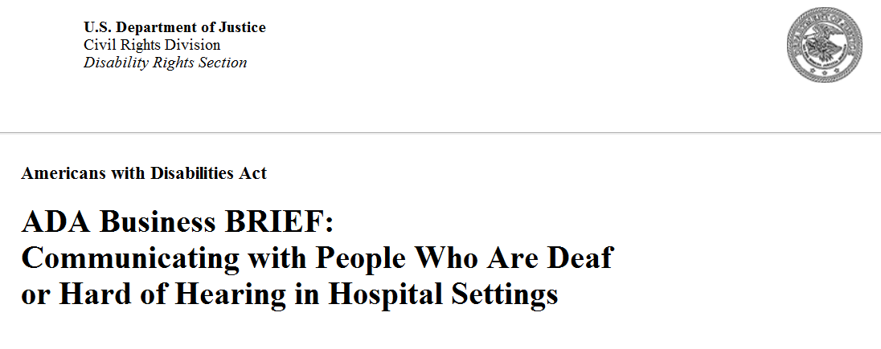
Two DOJ Publications Provide Very Helpful Guidance

Slide 35
Qualified Interpreter
If an interpreter is required, a covered entity must furnish a “qualified interpreter.” 28 C.F.R. §§ 35.104 & 36.104.

Slide 36
Requirements for a “Qualified Interpreter”
Able to interpret:
Effectively – interprets both receptively (i.e., understanding what the person with the disability is saying) and expressively (i.e., having the skill needed to convey information back to that person) using the sign language of the individual needing the interpreter (e.g., ASL, Signed English, etc.)
Accurately
Impartially
Understanding the necessary specialized vocabulary that is used for the particular setting (e.g., not all interpreters are qualified for medical settings).
28 C.F.R. § 36.104 (definition of “qualified interpreter”); see also Technical Assistance Manual, § III‑4.3200.

Slide 37
Question 4
You have an employee who took two semesters of American Sign Language in high school. Is she qualified to interpret for a care planning meeting to discuss services that SNF will be providing to a resident, who is deaf and uses ASL as her primary means of communication?

Slide 38
Use of Staff Who Sign “Pretty Well”
Can a public accommodation use a staff member who signs “pretty well” as an interpreter for meetings with individuals who use sign language to communicate?
Signing and interpreting are not the same thing. Being able to sign does not mean that a person can process spoken communication into the proper signs, nor does it mean that he or she possesses the proper skills to observe someone signing and change their signed or fingerspelled communication into spoken words. The interpreter must be able to interpret both receptively and expressively.
Americans with Disabilities Act, Technical Assistance Manual, § III‑4.3100.

Slide 39
Is Certification Necessary?
If a sign language interpreter is required for effective communication, must only a certified interpreter be provided? No. The key question in determining whether effective communication will result is whether the interpreter is “qualified,” not whether he or she has been certified by an official licensing body. A qualified interpreter is one “who is able to interpret effectively, accurately and impartially, both receptively and expressively, using necessary specialized vocabulary.” An individual does not have to be certified in order to meet this standard. A certified interpreter may not meet this standard in all situations, e.g. , where the interpreter is not familiar with the specialized vocabulary involved in the communication at issue.
Americans with Disabilities Act, Technical Assistance Manual, § III‑4.3100 (emphasis added).

Slide 40
Examples Of Failing To Retain A “Qualified Interpreter”
In Fairfax Nursing Center and Arlington Sherriff, these entities enlisted personnel, who did not have the requisite skills to be a “qualified interpreter,” to facilitate communication for important meetings without first having the employees evaluated to determine whether they had the requisite ASL skills to perform as an interpreter. My office arranged to have these employees’ ASL skills evaluated, which revealed that they did not have the requisite skills to be “qualified interpreters.”
https://www.ada.gov/fairfax_nursing_ctr_sa.html
https://www.ada.gov/arlington_co_sheriff_sa.html

Slide 41
Qualified Interpreter Must Be Able to Convert Spoken Language Into Signs
“Many commenters questioned the proposed deletion of the requirement that a qualified interpreter be able to interpret both receptively and expressively, noting the importance of both these skills. Commenters noted that this phrase was carefully crafted in the original regulation to make certain that interpreters both (1) are capable of understanding what a person with a disability is saying and (2) have the skills needed to convey information back to that individual. These are two very different skill sets and both are equally important to achieve effective communication.”
Section by Section Analysis of ADA Regulations

Slide 42
Question 5
If an individual who needs a sign language interpreter also has another disability, such as paralysis due to a stroke, what type of interpreter services should you look for?

Slide 43
Interpreters Must Be Effective
In order for an interpreter to be a “qualified interpreter,” s/he must be able to interpret “effectively” for the individual needing the interpreting services.
28 C.F.R. § 35.104 & 36.104.

Slide 44
Certified Deaf Interpreters
“Certified Deaf Interpreters are deaf or hard of hearing interpreters who work with hearing sign language interpreters to meet the specific communication needs of deaf individuals.”
Section-by-Section Analysis of the ADA regulations
“A CDI can facilitate communication with patients who have limited language skills or severe language deficits, neurologic and/or cognitive deficits, or a major mental illness.”
“More than signing: Communicating with the Deaf,” Nursing Management (March 2014), at 20-27.
CDIs are particularly important for consumers with language dysfluency.

Slide 45
Question 6
You have a consumer who is both deaf and blind. What kind of auxiliary aid or service might work for that consumer?

Slide 46
Answer 6
There are specialized interpreters for individuals who are both deaf and blind that use tactile or pro-tactile interpreting.

Slide 47
Question 7
A skilled nursing facility sets up a care planning meeting for a resident. The resident wants his son, who is deaf, to participate in the care planning meeting. Is the SNF required to provide a sign language interpreter for his son?

Slide 48
ADA’s Effective Communication Requirement Covers Patients and “Companions”
The ADA regulations require public accommodations to furnish auxiliary aids and services to “individuals with disabilities” and “companions who are individuals with disabilities.” 28 C.F.R. § 36.303(c).

Slide 49
Companion is Broadly Defined
“‘[C]ompanion’ means a family member, friend, or associate of an individual seeking access to, or participating in, the goods, services, facilities, privileges, advantages, or accommodations of a public accommodation, who, along with such individual, is an appropriate person with whom the public accommodation should communicate.” 28 C.F.R. § 36.303(c)(1)(ii).

Slide 50
Spotsylvania Regional Medical Center
Spotsylvania Regional Medical Center
Failure to provide ASL services to the daughter, who is deaf, of a patient during critical interactions, including a late night emergency admission and discussions regarding end of life issues. Equitable relief and $121,000 in compensatory damages.

Slide 51
Question 8
You notice that a patient, who is deaf, is communicating with a family member using sign language. May you ask the family member to act as an interpreter for a meeting in which a sign language interpreter is necessary?

Slide 52
ADA Prohibition on Relying Upon Adult Companions to Facilitate Communication
A public accommodation shall not rely on an adult accompanying an individual with a disability to interpreter or facilitate communication except –
In an emergency involving an imminent threat to the safety or welfare of an individual or the public where there is not interpreter available; or
Where the individual with a disability specifically requests that the accompanying adult interpret or facilitate communication, the accompanying adult agrees to provide such assistance, and reliance on that adult for such assistance is appropriate under the circumstances.
28 C.F.R. § 36.303(c)(3).

Slide 53
ADA Prohibition on Relying Upon Child Companions to Facilitate Communication
“A public accommodation shall not rely on a minor child to interpret or facilitate communication, except in an emergency involving an imminent threat to the safety or welfare of an individual or the public where there is no interpreter available.”
28 C.F.R. § 36.303(c)(4).

Slide 54
Good Neighbor Homes Inc.
In Good Neighbor Homes, Inc., staff members relied upon a family member to facilitate communication.
$40,000 in compensatory damages for the family member.
https://www.ada.gov/gnhi_sa.html

Slide 55
Question 9
An individual is brought to the emergency department of a hospital at 2:30 a.m. because she is throwing up blood and is in respiratory distress. Her daughter, who is deaf, is with the patient. Is the hospital required to furnish a sign language interpreter to the daughter at that hour?

Slide 56
The ADA Requires Hospitals to Ensure That Interpreters are Available for After-Hours Emergencies
Hospitals are required to ensure that qualified interpreters are readily available for after-hours emergencies. A Department of Justice publication, entitled, “ADA Business Brief: Communicating with People Who Are Deaf or Hard of Hearing in Hospital Settings,” explains that:
“Hospitals should have arrangements in place to ensure that qualified interpreters are readily available on a scheduled basis and on an unscheduled basis with minimal delay, including on-call arrangements for after-hours emergencies. Larger facilities may choose to have interpreters on staff.”
(Emphasis added).

Slide 57
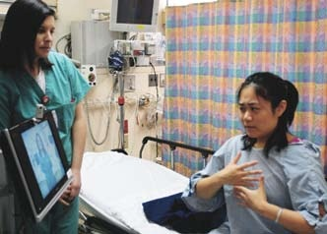
Video Remote Interpreting -- VRI
Real-time video and audio with high-quality images (no lags, blurriness, chops or irregular pauses in communication)
Sufficient dedicated wide-bandwidth connection
Large enough screen
Clear voices
Training to staff for quick set-
up and proper operation
28 C.F.R. 36.303(f)

Slide 58
Some Limitations of VRI
(1) If many people are talking in a room
(2) Physical conditions (room layout)
(3) Poor eyesight
(4) Physical limitations of the individual needing the interpreting services, such as medically unable to focus on a video screen.

Slide 59
Question 10
You have a 60 minute appointment set up with a patient who is deaf, and have arranged to have VRI available for the meeting. You turn on the VRI and it does not work properly. What do you do?

Slide 60
Public Accommodations Must Ensure Effective Communication During Each Interaction
Health care provider is responsible for providing appropriate auxiliary aids including an interpreter for each interaction with the individual who needs one.
Courts have focused upon each interaction when an interpreter was necessary and not the interactions as a whole in order to determine whether there has been a violation of the ADA. Proctor v. Prince George’s Hosp. Cntr, 32 F.Supp.2d 820, 827-28 (D.Md. 1998).

Slide 61
Lip Reading is not a Reliable Method of Communicating
One study found that the “[m]ean-word-recognition accuracy scores [in a lip reading recognition test] were barely greater than 10% correct.” J Acoust Soc Am. 2011 Jul; 130(1): 1–4.

Slide 62
25% of the Message
---------removed ----- a -------- is ------ -- --------laboratory, ----- --- ----------into ----- ---------- for ----- ------- -- ----------. ----- ----- known -- -------- ----- ----------- and --- ----- ---- best ------ to tell ---- cancer is ----------. ----- --------------- also ----- --------- (cell) material. ------------- ----- is ------- -- urine, --------- (---- ---- around ---- ------- ---- -------- cord), ------- (mucus ---- --- -----), --------- (------------cavity) -----, ------- (chest ------) -----, ----------/-------- -----------, and ---- ----- -------- during - --------.
Notes:
1. What do you think is going on?
2. What is the prognosis?
3. What are the next steps?
4. What kind of test will be performed.

Slide 63
Actual Message
Tissue removed during a biopsy is sent to a pathology laboratory, where it is sliced into thin sections for viewing under a microscope. This is known as histologic (tissue) examination and is usually the best way to tell if cancer is present. The pathologist may also examine cytologic (cell) material. Cytologic material is present in urine, cerebrospinal fluid (the fluid around the brain and spinal cord), sputum (mucus from the lungs), peritoneal (abdominal cavity) fluid, pleural (chest cavity) fluid, cervical/vaginal smears, and in fluid removed during a biopsy.

Slide 64
Question 11
A skilled nursing facility resident uses sign language for communication and needs a device capable of video telephone calls so that she can communicate using sign language, what responsibilities does a covered entity have to ensure such a device is available?

Slide 65
Answer 11
The ADA regulations define “auxiliary aids and services,” to include “video-based telecommunication products and systems.” 28 C.F.R. § 35.104 & 36.303(b)
“A public accommodation that offers a customer, client, patient, or participant the opportunity to make outgoing telephone calls using the public accommodation´s equipment on more than an incidental convenience basis shall make available public telephones, TTYs, or other telecommunications products and systems for use by an individual who is deaf or hard of hearing, or has a speech impairment.” 28 C.F.R. § 36.303(d)(2).

Slide 66
Devices Capable Of Video Telephone Calls
“GNHI agrees to provide appropriate accessible telecommunication equipment in each group home in which a Resident who is deaf or hard of hearing resides, including devices capable of video telephone calls, hearing aid compatible telephones, volume control telephones, and/or Video Relay Services for use by Residents and members of the public at the GNHI’s group homes.” https://www.ada.gov/gnhi_sa.html

Slide 67
Question 12
A healthcare provider receives a telephone call from a consumer through the telephone relay service established for individuals who are deaf or hard of hearing, which includes a sign language interpreter, how should it handle the call?

Slide 68
Calls Through a Relay Service
Covered entities “shall respond to telephone calls from a telecommunications relay service established under title IV of the ADA in the same manner that it responds to other telephone calls.” 28 C.F.R. § 35.161(c) & 36.303(d)(4).

Slide 69
Information and Communication Technology (ICT)
ICT is information technology and other equipment, systems, technologies, or processes, for which the principal function is the creation, manipulation, storage, display, receipt, or transmission of electronic data and information, as well as any associated content.
Examples include: computers and peripheral equipment; information kiosks and transaction machines; telecommunications equipment; customer premises equipment; multifunction office machines; software; applications; web sites; videos; and electronic documents.

Slide 70
ICT (cont.)
Auxiliary aids and services for effective communication include various types of ICT, such as real time computer-aided transcription services and video-based telecommunication products.
ICT also includes the web content (such as web sites and mobile applications) that many health providers use to advertise services and provide program information.
Health programs and activities provided through ICT must be accessible to individuals with disabilities unless doing so would result in undue financial and administrative burdens or a fundamental alteration in the nature of the health programs or activities. 45 C.F.R. § 92.104.

Slide 71
Telehealth
Telehealth has become a more widespread method to provide and receive health care services, especially during the COVID-19 Public Health Emergency.
Telehealth can take a number of forms, including communication between a patient and a health care provider via video, phone, or other electronic means.
While telehealth may be a convenient and effective way for patients to receive health care, telehealth that is inaccessible to individuals with disabilities results in barriers that may violate Federal civil rights laws.

Slide 72
Examples of Inaccessible Telehealth
A person who is blind or has limited vision may find that the web-based platform their doctor uses for telehealth appointments does not support screen reader software.
A person who is deaf and communicates with a sign language interpreter may find that the video conferencing program their provider uses does not allow an interpreter to join the appointment from a separate location.

Slide 73
Guidance on Nondiscrimination in Telehealth
On July 29, 2022, HHS OCR and DOJ released Guidance on how Federal disability rights laws, including Section 504, the ADA, and Section 1557 require telehealth programs and activities to be accessible to individuals with disabilities. https://www.hhs.gov/about/news/2022/07/29/hhs-and-doj-issue-guidance-on-nondiscrimination-in-telehealth-the-week-of-the-32nd-anniversary-of-the-americans-with-disabilities-act-ada.html
The guidance covers general nondiscrimination requirements, reasonable modifications, and effective communication as they pertain to telehealth.

Slide 74
Rulemaking
On August 4, 2022, HHS OCR published a notice of proposed rulemaking (NPRM) to revise its implementing regulation for Section 1557. In addition to continuing to require that health programs and activities provided through ICT be accessible, the Section 1557 NPRM would explicitly require that telehealth services be made accessible. The NPRM would also require that covered entities implement effective communication procedures in their health programs and activities. Comments closed on October 3, 2022.

Slide 75
Rulemaking (cont.)
HHS indicated in the 2022 Fall Unified Agenda it is undertaking Rulemaking on Discrimination on the Basis of Disability in Health and Human Services Programs or Activities under Section 504.
DOJ indicated in the Spring 2022 Unified Agenda that it intended to publish a NPRM to update the ADA Title II regulation with new web content accessibility requirements.

Slide 76
Common Issues That Have Arisen in Barrier-Free Health Care Initiative cases: Effective Communication
Failure to obtain interpreter for late night emergency admissions to hospital
Enlisting family members, friends and/or unqualified staff members to facilitate communication
VRI issues: (1) staff does not know to set up VRI and/or (2) the VRI system is not working properly
Inappropriate reliance on hand-written notes for individuals whose primary means of communication is ASL
Erroneously assuming that an individual who is deaf or hard of hearing can read lips and does not need an auxiliary aid or service
Refusal to provide auxiliary aids and services due to cost
Failure to train staff on the ADA’s requirements and the services available to individuals who are deaf or hard of hearing

Slide 77
Legal Principles Addressing Common Issues
Generally, health care providers are required to furnish auxiliary aids and services including interpreters and may not require the person with a disability to bring their own. 28 C.F.R. § 36.303(c)(2).
Health care providers may not enlist companions to interpret. 28 C.F.R. § 36.303(c)(3).
ADA regulations define “qualified interpreter” to be someone who can interpret effectively, accurately, impartially and understands the necessary specialized vocabulary. 28 C.F.R. § 36.104.
A patient’s companion, who is deaf or hard of hearing, is also entitled to effective communication. 28 C.F.R. § 36.303(c)(1).
In order for VRI to be effective communication, users must be trained to quickly and efficiently set up and operate the VRI. 28 C.F.R. § 36.303(f)(4).

Slide 78
ADA Enforcement Actions: Failure to Provide Effective Communication (Nursing Facilities, Hospitals, Physician Offices)
Commonwealth Health & Rehab Center
Failure to provide ASL Interpreter to rehab patient, who is deaf, and his Mother and Sister, who are also deaf, during 27-day physical rehabilitation stay at the facility. Equitable relief, $160,000 in compensatory damages & $2,500 civil penalty.
Spotsylvania Regional Medical Center
Failure to provide ASL services to the daughter, who is deaf, of a patient during critical interactions, including a late night emergency admission and discussions regarding end of life issues. Equitable relief and $121,000 in compensatory damages.
Center for Orthopaedic and Sports Medicine, Inc.
Failure to provide ASL interpreter to deaf patient during multiple medical appointments. Orthopedic practice incorrectly informed patient that she needed to obtain her own interpreter. Equitable relief and $15,000 in compensatory damages.

Slide 79
HHS Effective Communication Enforcement Actions
In November of 2022, HHS OCR entered into a voluntary resolution agreement with a 280 bed hospital concerning allegations that a patient presenting at the emergency department was not provided appropriate auxiliary aids and services in a timely manner.
In March of 2022, HHS OCR and the USAO for the District of Rhode Island entered into a settlement agreement with a state agency responsible for child welfare concerning allegations that parents were not provided ASL interpreters during child welfare investigations.

Slide 80
Staff Training is Critical
A critical and often overlooked component of ensuring success is comprehensive and ongoing staff training. Covered entities may have established good policies, but if front line staff are not aware of them or do not know how to implement them, problems can arise. Covered entities should teach staff about the ADA’s requirements for effective communication, HIV and accessible equipment. Many disability organizations can provide ADA trainings.

Slide 81
Legal Requirements and Guidance Materials
The Americans with Disabilities Act (“ADA”). 42 U.S.C. § 12101, et. seq.
The ADA regulations. 28 C.F.R. Parts 35 (Title II) & 36 (Title III).
The section by section analysis of the ADA regulations.
The ADA Technical Manuals for Title II and Title III.
DOJ Business briefings on ADA.gov.
Section 504 of Rehabilitation Act of 1973. 29 U.S.C. § 794(a).
Rehabilitation Act of 1973 regulations. 45 C.F.R. §§ 84 and 85.
Section 1557 of the Affordable Care Act. 42 U.S.C. § 18116.
Section 1557 regulation. 45 C.F.R. § 92.
Case law interpreting these legal authorities.

Slide 82
National Association of State Agencies for the Deaf and Hard of Hearing
Provides resources and services for individuals who are deaf, hard of hearing, or deaf blind.
http://nasadhh.org/

Slide 83
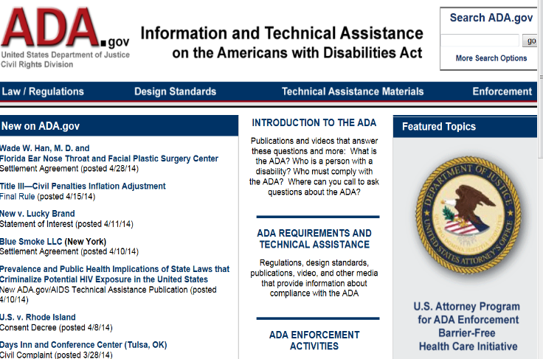
Most Important ADA Resource: ADA.gov 1
Statutory Language
Regulations
Technical Assistance
Settlement Agreements

Slide 84
Filing a Complaint
Information on how to file a civil rights complaint with DOJ is available at: https://civilrights.justice.gov/
Information on how to file a civil rights complaint with HHS is available at: https://www.hhs.gov/ocr/complaints/index.html
For questions about the ADA, you can contact the ADA Information Line at 800-514-0301 (voice) or 1-833-610-1264 (TTY).

Slide 85
Contact Information
Steven Gordon
Steve.gordon@usdoj.gov
(703) 299-3817
John Thompson
John.Thompson@hhs.gov
Lisa Bothwell
Lisa.bothwell@acl.hhs.gov

